Slide 1



Reinhard F. Werner
Institut für Theoretische Physik
Leibniz Universität Hannover
Is an ontological
commitment at the quantum level
helpful for good physics?
New directions in
the Foundations of Physics
Washington
April 24, 2015
Version including
some comments by
Shelly Goldstein

Slide 2
Introduction
(introducing myself)
mathematical quantum physicist
Statistical Mechanics, recently mostly Q Information
student of Günter Ludwig

Slide 3
I am a Realist
in the sense every scientist should be
Build theories/explanations that can clash with
experience/experiment
Avoid lines of reasoning/investigation known to be
error prone
Appeal to authority/scripture,
free fantasy
formalized methodology
Don‘t fool yourself (and others)
Check on your confirmation bias and
premature hypothesizing

Slide 4
I am a Realist about
observational data
This is naive
but required for the enterprise of empirical science
always needs critical evaluation
Other claims to reality
Can only be stated in the context of a theory
can only refer to theoretical terms
crucially depend on the role a term plays in the theory
A claim is especially weak, when the term
depends on arbitrary choices (eg vector potentials)
Can be eliminated without change of empirical content

Slide 5
If claims to Reality depend on the role of a notion
in the “best theory about the subject“,
what makes a “good theory“?
empirical correctness
power of the formalism to actually reach conclusions
manageable computational complexity
Example of a “bad theory“:
quantum mechanics applied to 10²⁴ particles
Needs special situations and “approximations“,
which must be counted as part of a theory (Stat. Mech)
(Theory≠ Axioms ∧ “all conclusions thereof“)

Slide 6
Introduction
(introducing myself)
mathematical quantum physicist
Statistical Mechanics, recently mostly Q Information
student of Günter Ludwig
I see my job as
Explaining how QM works and what we can expect
Clarifying conceptual issues
Increasing the strength of the quantum formalism
Increasing the expressive power of QM
Consolidating reduction relations between theories
and models

Slide 7
Historical Examples

Slide 8


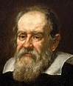
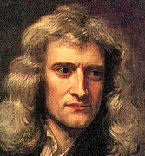
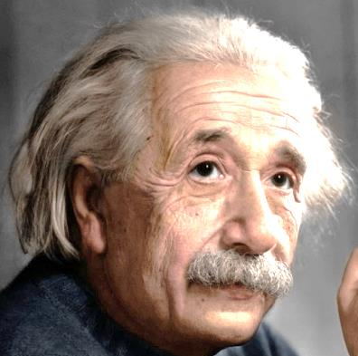
Earth around Sun
Really ?
Sun gives better inertial frame !
Coordinate choice. So what?

Slide 9
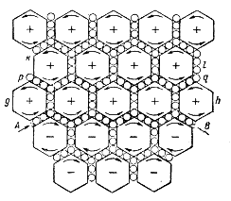
The Ether
Mechanical metamaterial
Maxwell 1861
Continuous medium
with funny properties
It matters little whether the ether really exists; that is
the affair of the metaphysicians. The essential thing for
us is [...] that this hypothesis is convenient for the ex-
planation of phenomena. After all, have we any other
reason to believe in the existence of material objects?
[...] no doubt, some day the ether will be thrown
aside as useless.
Poincaré 1888 (cited after Darrigol)
dispensible
forgotten

Slide 10
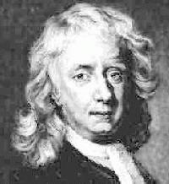
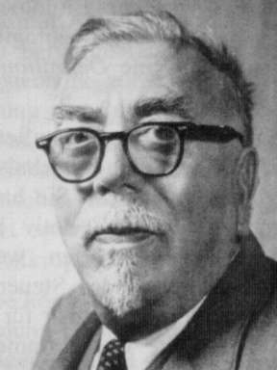
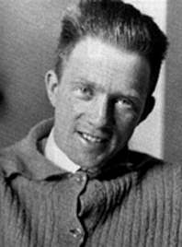
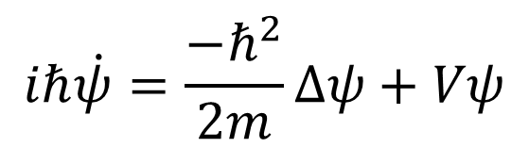


Apfel
Continuity and Continuum
An apple’s trajectory
$$m{\ddot{x}}_{k}=−\frac{∂V}{∂x_{k}}$$
2x differentiable
$$dx_{k}=v_{k}dt+dW_{k}$$
nowhere differentiable
$$iℏ\dot{ψ}=\frac{−ℏ^{2}}{2m}∆ψ+Vψ$$
Trajectory?

Slide 11
How real are the reals?
Like all mathematical objects they are human inventions
(but mathematical Platonism is beside the point here)
Could we not do Physical Geometry with all distances
rational
constructible with ruler and compass
real
hyper-real (non-standard analysis)
unique!
At any finite accuracy these are indistinguishable
refinement process = Hausdorff completion
Idealization patches up our ignorance of small scale geometry

Slide 12
Quantum Mechanics
Bullshit
Although quantum mechanics is hugely successful
practically, its interpretation is still a matter of debate.
Legitimate question of any student:
Tell me what I need to know (e.g., about interpretation)
to participate in that success story.

Slide 13
Quantum Mechanics
some good news...
There is only one interpretation
and there is consensus about this
This interpretation is local
Quantum mechanics has
no measurement problem

Slide 14
There is only one interpretation
and there is consensus about this
Depends on what you mean by interpretation
(a) A basic set of rules for connecting observations
to elements of the mathematical formalism
agreement (e.g., Q Information community)
(b) “Spelling out an ontology“ (Esfeld)
less
agreement
Poetic interpretation
Natural Philosophy 19th century style

Slide 15

A basic set of rules for connecting observations
to elements of the mathematical formalism
Minimal Statistical Interpretation
Operational Quantum Mechanics
preparation, state
measurement, observable
ρ
F
0
1000100101100110101001100101110101000100100100110
p(1) p(0)
Theory only refers to such probabilities.
, tr(ρ F ).

Slide 16
Quantum Mechanics is
a probability theory without sample spaces
= a generalized probabilistic theory (GPT)
= convex state space approach (Ludwig 1960s)
≈ ensemble interpretation (Einstein, von Neumann`26)
No unique decomposition into pure states
No dispersion-free states
States (=“probability distributions“) are not
distributions of “objective“ properties
No conditioning (in general)

Slide 17
Remark about Probability:
Subjective vs. frequentist
“Subjects“, rational agents etc
are constrained by rationality rules
and Bayes‘ rule to act like frequentists
For frequentism “probability“ is a theoretical term
in a theory of random sources
Applicability of this theory never follows
from observation alone, but is partly a subjective decision
Difference not as great as it may seem,
especially when there are sufficient data
Agreement on: Probability distributions or Ψ
are not attributes of individual systems

Slide 18
The minimal interpretation is local
No operation on one part of a system makes a detectable difference on another part, unless interaction is explicitly included
Prototype locality already assumed in the setup:
Ludwig: Principle of directed interaction
No backreaction from measurement to preparation
Also needed to define “channels“
operating on “unknown quantum states“
x
Informational turn:
Analyze systems in terms of what can be encoded on them and reliably read out

Slide 19
The shape of the state space
= key structural feature of the system type in
a generalized probabilistic theory (GPL)
A theory is called classical iff
any two convex decompositions of a state have a common refinement
(no Schrödinger steering)
any state has a unique decomposition into extreme points
(state space is a “simplex“)
sample
space
the faces of its state space form a distributive
lattice (Boolean logic)
any two observables can be measured jointly
there is “finest“ observable, from which all others can be simulated by post-processing
Every observable can be measured without disturbance

Slide 20
You assume classicality, if you demand
a description of individual systems in terms of
“real factual situations“ (Maudlin, mail Apr. 16)
elements of reality (EPR)
a variable λ (Bell 1964)
This is a highly non-trivial step beyond
the minimal interpretation.

Slide 21
Quantum mechanics has no measurement problem
Fixed “objective“ results are the starting point.
However, some textbook accounts have an MP.
Better do without:
Quantum Fundamentalism
instead: QT does not apply directly to Macroscopic Bodies
need StatMech for emergence of Classicality
Projection Postulate & “Dual Evolution“
instead: general “instruments“
measuring ≠ filtering for “properties“
A “measurement problem“ arises only as a consistency
problem: Checking that fixed results are consistent with
the Quantum Statistical Mechanics treatment of devices.

Slide 22
Bell‘s Theorem*
A theory cannot have all three of the following features
Correlation Experiments
explained
Classical Description
Joint measurability
Hidden variables
Counterfactual definiteness
“Realism“ ...
Locality
No Bell‘s telephone
Relativistic causality
* Maybe not what he thought he proved, but what we learned from him.

Slide 23
Bell‘s Theorem
One can prove this in the form:
Correlation Experiments
violating CHSH
Classical Description
Joint measurability of Bob‘s
measurements
Violation of Locality
Signalling just
on correlations

Slide 24

In Operational Quantum Mechanics
Correlation experiments
ok
Classical
Description
Locality
No Bell‘s telephone
Relativistic causality

Slide 25
Bell‘s Theorem (Bohmian Style)
Correlation Experiments
with CHSH outcomes
There is NO ASSUMPTION HERE
“Real factual situation“ is taken
for granted as feature of any theory.
Nonlocality
of Nature herself
(no theory required)

Slide 26

Choose !
will you take
Classicality
and try to save the world
you used to know
or will you take
Locality
and enter the world
of matrix mechanics
So let us play a bit with the Blue Pill

Slide 27
Bohmian Mechanics
I will only refer to the Goldstein et al version
(ignoring differences to David Bohm‘s version)
My encounters:
Friends doing Nelson‘s stochastic mechanics (early 80s)
Paper (1986) on generalizations
Various rounds with Detlef Dürr
Paper on multi-time correlations
Quantum theory without observers III
Clash via blog (April 2013)
Comment on Tim Maudlin‘s “What Bell did“.
Last summer: Long email exchange on a detector problem

Slide 28
Bohmian criticism of QM
A theory must be about something
Note: “QM is about atomic scale physics“
seems to count for nothing

Slide 29
Bohmian criticism of QM
A theory must be about some thing
Note: “QM is about atomic scale physics“
seems to count for no thing

Slide 30

Bohmian criticism of QM
A theory must be about some thing
The solution: Thingify all you can!
Ψ
Q

Slide 31
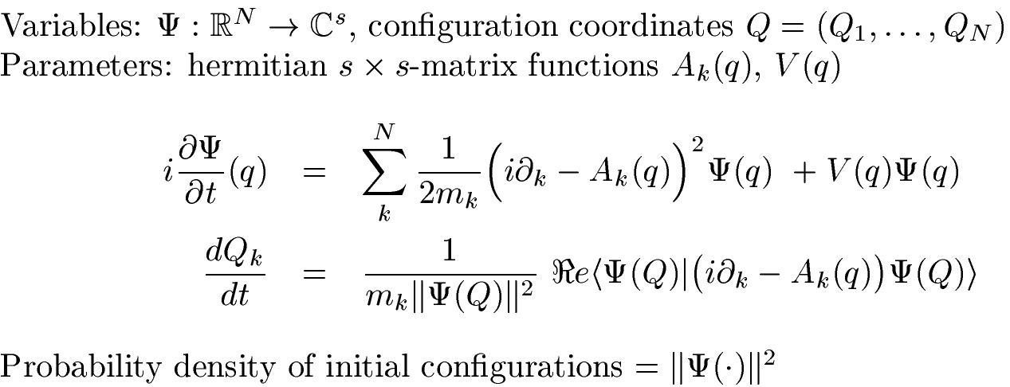
Bohmian Mechanics
This will then remain true for all times ( “Quantum equilibrium“)

Slide 32

Ψ
Bohmians are not alone in
committing this category mistake
Einstein attacked this as the “orthodox view“
of the wave function from 1927-1955
One of the agendas of the EPR paper is to
attack this (I think successfully)
Effectively this is a spooky variable theory
And responsible for a good deal of the
supposed “non-locality“ of QM.

Slide 33
I
Ensemble Interpretation
Operational quantum mechanics /minimal int.
systematizes theoretical and experimental practice
“incomplete“ and not ashamed of that
puts Ψ here
Einstein @ Solvay 1927
“orthodox“ view
plain category mistake
still held by many
puts Ψ here
II
Individual State Interpretation

Slide 34

Q
Heisenberg told you that you cannot have trajectories.
Here they are! Cool!
Why are the situations and ∪ so different?
Shouldn‘t each particle see just one hole?
Unsatisfying explanation:
You have to compute different Ψs. Shut up and do it.
Bohmian explanation:
You have to compute different Ψs. Do it and then solve the guiding eq. ( ⇒ different patterns). Now shut up.
Ok. Sorry. That was asking too much.

Slide 35


Q
BM must share a grain of truth with QM, because ρ_{t}(x)=|Ψ_{t}(x)|² for all t
This is easy to get
→
→
Can add any velocity term v with div(vρ)=0
Can also add a diffusion term (Nelson), any diffusion constant
Can replace Q by any abelian subalgebra
(also finite dimensional/discrete/momentum, RFW, `86)
Can let mixed states do the driving
No compelling arguments either way
Meet the
Bohmian Demon,
the only spectator
of Bohmian Reality
They
rarely
agree
Meet
Nelson‘s Demon,
the only spectator
of StochMech Reality

Slide 36
Q
BM must share a grain of truth with QM, because ρ_{t}(x)=|Ψ_{t}(x)|² for all t
This is easy to get
and also wrong just around the corner
(arXiv:0912.3740) Take two entangled, non-interacting particles.
Then two-time correlation functions make sense in both BM and QM
But they are quite different: eg QM: CHSH=2√2, BM: CHSH≤2
Bohmian Answer (arXiv:1408.1651):
Have to describe Q-measurement as a Bohmian process
⇒ Collapse by the first measurement
No special link Q_{BM} ↔ Q_{QM}
.

Slide 37
Q
BM must share a grain of truth with QM, because ρ_{t}(x)=|Ψ_{t}(x)|² for all t

Slide 38
Q
BM is empirically equivalent to QM, because ρ_{t}(x)=|Ψ_{t}(x)|² for all t
All the other quantum degrees of freedom?
They just are not real.
Have to describe entire experiment in BM language.
Then since ultimately every measurement ends in position dof
empirical equivalence is reestablished.
This preference for position is entirely ad hoc
Why not momentum measurements on photons (Jürg Fröhlich)?
Do we want to treat “result in pixel on screen“ and “result in ink on
paper“ as ontologically different?
Microscopically, we routinely transfer quantum states
between different degrees of freedom.
Need Bohmian Theory of Experiments

Slide 39
Bohmian Theory of Experiments I
Describe the whole experimental arrangement
in Bohmian terms.
The End
Allows to claim a definite outcome, because the
particles of the pointer hand are assigned some Q_{BM}.
This will tell us nothing about the empirical relevance
of the microscopic Bohmian trajectories:
All interaction via Ψ.
No known correlation between particle and detector Q_{BM}

Slide 40
Bohmian Theory of Experiments I
Correlation between particle and detector ?
45 pages of email correspondence (summer 2014), mainly
with Shelly (inconclusive).

Slide 41
Summary: Bohmian Theory (micro)
Strictly for the Bohmian demon
else could condition on his observations
threreby get signalling
subsystems out of Q equilibrium
Dependent on arbitrary choices (Nelson,...)
Usually at odds with physical intuition &
oddly biased towards position vs. other physics
Shelly to me (Bielefeld`13)
You as an operationalist should not complain about our
not taking spin seriously: For you nothing is real.
Me (now): Why not be an atheist about just one more?

Slide 42
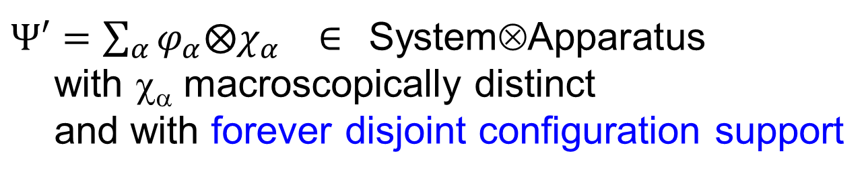
Bohmian Theory of Experiments II
ariXiv: quant-ph/0308038
Use strong assumptions about the form of
Ψ after the experiment:
These are mostly copied from the formal theory of
measurement (von Neumann, Busch/Lahti/Mittelstaedt...)
$Ψ′=\sum_{α}{φ_{α}{⨂χ}_{α} ∈ }$System⊗Apparatus
with χ_{α} macroscopically distinct
and with forever disjoint configuration support
No need to follow the trajectories.
When transition is by a fast unitary: get collapse

Slide 43
Bohmian Theory of Experiments II
ariXiv: quant-ph/0308038
7: Genuine Measurements
Necessary condition for measurability of a random variable:
outcome probability distribution= sesquilinear in Ψ
“... neither the velocity nor the wave function [nor any multitime
trajectory property] is measurable“
Empirically accessible part of Bohmian Mechanics
=
Operational Quantum Mechanics

Slide 44
A Bohmian piece of
False Advertising
Goldstein (Stanford Encyclopedia 2013):
  “In fact, quite recently Kocsis et al. (2011) have used
  weak measurements to reconstruct the trajectories for single
  photons “as they undergo two-slit interference,” finding
  “those predicted in the Bohm-de Broglie interpretation of
  quantum mechanics.”
Dürr&Lazarovici (Esfeld volume, 2013):
  “There is, however, the possibility, using ”weak
  measurements” [...] to reconstruct experimentally the
  trajectories of the particles. Just recently this was achieved
  for the famous double-slit experiment.“

Slide 45
The Bohmian micro/macro divide
For small systems, Q
must be hidden, lest we
can create
quantum nonequilibrium
signalling
On measuring instruments
the Q-configuration
is identified with the
observed outcomes
Demanding additional
assumptions on formal
measurement theory:
forever disjoint supports
of branches
purity of branches
All for only

Slide 46
Bohmian Achievements
Solution of the FNPP Measurement Problem
given strong solution of FAPP MP
Derivation of operational QM:
QM ∧ “Trajectories“⇒ QM
Clear notion of arrival times
but must be avoided to remain consistent
Restoration of microscopic Reality
for the eyes of the Bohmian Demon
Existence proof for Hidden Variables
by convincing demonstration why not to use them

Slide 47
Notes added after the workshop
Two active Bohmians, Shelly Goldstein and Travis Norsen, were present at the talk, and we naturally
discussed some of the issues in the next available break. I asked Shelly to send me some comments
for inclusion in the posted version of the slides. These can now be found beginning on the next page.
One participant asked for the reference mentioned on slide 35. It is
RFW: “A generalization of stochastic mechanics and its relation to quantum mechanics”.
Phys. Rev. D 34(1986) 463-469.
Ruth Kastner complained about the “Bullshit” on slide 12, as not doing justice to the serious work that is actually
being done on the issue of interpretation. She is right, of course. What I was mainly objecting to is that line
about the unsettled interpretation being used as part of the general mystification of QM.
Slide 25 refers to a debate I had with the Bohmian camp last year. The editors of a special JPhysA special issue
celebrating 50 years of Bell‘s inequalities (freely available at http://iopscience.iop.org/1751-8121/47/42 )
had asked me to comment on a contribution “What Bell did“ by Tim Maudlin (see arXiv:14081826)
because it was quite polemical and quite against the mainstream view on the topic. Tim was just echoing the usual
Bohmian line (see also the Scholarpedia article (http://iopscience.iop.org/1751-8121/47/42) by Shelly et al.
My comment (see the special issue) received a countercomment by Tim (arXiv:1408.1828), showing that I had
utterly failed to get through to him (see also arXiv:1411.2120). Probably it is a matter of stating the assumption in
words Bohmians recognize. At the workshop Travis at least agreed to the statement that Bohmians like to
think of a theory as something involving some “complete description of the real factual situation independently
of what measuring devices we choose to employ“. Only you should perhaps not talk of a “description“ because
it is Nature herself, which has that real factual situation.
Since QM clearly does not work that way, and I somehow lack that direct access to the ‘Ding an sich‘,
I still call that an assumption.

Slide 48
Comments by Shelly Goldstein, mostly on the last slide
(replies and further comments from me in [...])
[Measurement problem]:
I probably basically agree with that---though I don't remember what is meant by FNPP. In any case, quantum mechanics as you understand it does not have a measurement problem as usually understood in the foundations of quantum mechanics, the problem of how typical quantum measurements can end up having results (a pointer pointing this way or that way, etc.) if the wave function of the system--apparatus composite is a complete description of that system. Neither for you nor for Bohmian mechanics does this particular problem arrive, because the wave function is most definitely not a complete description of the relevant system.
One important difference between us here is that for you the wave function is not really an objective element of the system at all, but just a computational device, whereas for Bohmian mechanics the wave function must be taken more seriously. We would presumably disagree about whether that is a virtue or a vice.
[FNPP was an abbreviation of “for no practical purpose“]

Slide 49
[QM ∧ “Trajectories“⇒ QM]
By “Trajectories“ here you of course mean the guiding equation of Bohmian mechanics, the additional equation
with which BM supplements Schroedinger's equation. That's fine.
But you're not properly expressing here the derivation. What is important is this: On the left only a part of
QM is relevant, namely Schroedinger's equation itself. And on the right it is a different part of quantum
mechanics that is relevant, namely the quantum measurement formalism involving Born probabilities,
operators as observables, POVM's, etc. Those things are certainly not part of the formulation of Bohmian
mechanics. They are simply what emerge as a convenient means of description when Bohmian mechanics
is applied to an analysis of results of experiments.
[I accept that.
But what was the achievement, really? It only shows that if you apply the raw quantum formalism to
an indirect measurement, it practically does not matter how you describe the readout at the macroscopic level.
Even Bohmian position will do, but only if you make sufficiently strong assumptions guaranteeing that the
devices live up to macroscopic expectations. You see that this fails right away if you dare to move a
Heisenberg cut in one of the earlier stages of a measurement (A perfectly standard thing in QM for getting
a more detailed analysis of some measurement.) ]

Slide 50
[Arrival times]
I wouldn't say that they must be avoided. Rather one must simply be careful. In some situations the
Bohmian arrival times correspond precisely to the quantum probability current and provide a principled
explanation of why the current provides the relevant answer. But in other situations it is not the Bohmian
arrivals that are reflected in the measurement results. There is nothing terribly mysterious about this.
One has to be sure the experimental arrangement is such that the arrivals becomes suitably correlated with
the appropriate apparatus variables. In Bohmian mechanics all the relevant variables are well defined,
but one must check that the interactions establish the appropriate correlations between them.
[I should comment on this, because it is a residual reference to a section that I deleted from the talk for lack
of time.
Indeed, in the 80s I wrote a couple of papers on QM arrival time. I did feel it annoying that the time of
detector clicks are routinely recorded in the lab, but textbooks were mostly silent on how to set up the
observables for that. (See my papers http://www.itp.uni-hannover.de/~werner/WernerByTopic.html#j14)
The Bohmian or Nelsonian approach has obvious first hitting distributions, but these do nothing to alleviate
the problem, since they cannot be what we get from an actual detector (Trajectory properties are not
measurable). The Bohmian works on this and Shelly‘s answer make the point that sometimes the Bohmian
arrival distribution is sort of ok, and maybe not totally off.
Having worked on this, and in particular on finding better alternatives than the probability current, I find it
sad that Shelly‘s answer takes that current (which is quadratic in Ψ, hence “measurable“) as the relevant
answer. ]

Slide 51
[The eyes of the Bohmian Demon]
A crucial element in establishing the empirical equivalence between BM and orthodox quantum theory is the proof that a Bohmian demon is not possible in a typical Bohmian universe: the sort of system that such a demon would have to be is no more possible that a perpetual motion machine. So the restoration of microscopic reality is not for the Bohmian demon. Rather its point is this: Microscopic reality is the basis of macroscopic reality. And in Bohmian mechanics the behavior of the fundamental micro-reality yields the observed behavior of the macro-reality on the basis of which we believe in quantum mechanics to begin with.
Where we differ here is this: I insist that measurement and observation are not fundamental, and should not be mentioned in the formulation of a fundamental physical theory. I insist, in other words, on a quantum theory without observers. You do not. You take a more practical stance towards physical theory. Therefore I have a much greater need for micro-reality. Without it one has real difficulty in insisting on a quantum theory without observers.
[I agree to this description of our disagreement]

Slide 52
[Existence proof for Hidden Variables by convincing demonstration why not to use them]
Naturally enough, I would express that a bit differently. Bohmian mechanics demonstrates that despite all the no-hidden-variables arguments claiming to establish the impossibility of hidden variables in quantum mechanics, what Bohmian mechanics shows is this: in order to overcome these argument one need only invoke the obvious ontology (that is, one requiring little imagination)---namely of particles, described by their positions ---evolving in the obvious way, namely according to the guiding equation, which one could hardly fail to find, in a great variety of ways, as soon as one bothers to look for it. From this OOEOW the quantum formalism, probabilities and all the rest, follows.
[I couldn‘t make sense of OOEOW.
And probabilities are clearly among the inputs to the theory, as the initial deed of the demon or God or whoever, of establishing quantum equilibrium. ]

Slide 53
[The Bohmian micro/macro divide: slide 45]
This makes it sound as if one *stipuates* that for small systems Q is hidden (in order to avoid some undesirable features). But this not so.
One does not stipulate any such thing. Rather, it simply turns out that when one analyzes BM one finds that the sorts of correlations that typically can arise in a Bohmian universe are incompatible with the sort of knowledge that would allow for signalliing, or for violation of the uncertainy principle or quantum probability formulas.
What you've written also makes it sound as if there is a genuine conflict between what is true for micro and what is true for macro.
There isn't. Both for micro and for macro (e.g., measuring instruments) one can not know the configuration of a system in more detail that its Born rule probability distribution, arising from its wave function, would allow. For the microrealm this is a strong limitation. For the macrorealm, it's not much of a limitation at all---because macro-masses are so very large (and because mechanisms of decoherence are so pervasive).
[Fair enough: The trajectories are irrelevant in the microcase and superfluous at the macro-level. The reason I bring this up is the tension I see between the proved invisibility of the micro-trajectories and their
supposed obviousness at the macro-level, when they are used as reality-givers for the measurement results. An example of invoking such “obvious relevance“ was given by Tim in our recent email exchange, asking me to consider the kind of theoretical prediction
that there is a large collection of particles with the shape of a cat moving in stereotypically cat motions, and the theory also (although this is less important) validates lot's of claims about how this collection would move if, say, a dog-shaped collection of particles came charging at it...
In Washington you mentioned the paper on the “Origin of absolute uncertainty“ as the place where your
above Born rule argument is made. I‘ll look at that again, but I am not convinced that this will resolve the tension.]

